Slide 1

Software Testing & Quality (07)
Compatibility Testing

Slide 2
Content
a. Overview of Compatibility testing
b. Platform and Application Version
c. Standards and Guidelines
d. Data Sharing Compatibility
System compatibility
Data compatibility

Slide 3
Highlights of this chapter include
What it means for software to be compatible
How standards define compatible
What platforms are and what they mean for compatibility
Why being able to transfer data among software applications is the key to compatibility

Slide 4
a. Overview of Compatibility testing
1. Software compatibility testing definition:
  Checking that your software interacts with and shares information correctly with other software
2. Software compatibility testing on a new piece of software, we will need to get the answer to a following few questions:
  1) What other platforms and application software is your software designed to be compatible with?
  2) What compatibility standards or guidelines should be followed that define how your software should interact with other software?
  3) What types of data will your software use to interact and share information with other platforms and software

Slide 5
a.1: Examples
Cutting text from a web page and pasting it into a document opened in your word editor
Saving accounting data from one spreadsheet program and then loading it into a completely different spreadsheet program
Having photograph touchup software work correctly on different versions of the same operating system
Having your word editor load in the names and addresses from your contact program and print out personalized invitations and envelopes
Upgrading to a new database program and having all your existing database load in and work just as they did with the old program
Notes:
spreadsheet：电子表格
Touchup：润色，修饰

Slide 6

a.2: Figure 9.1
Word Editor
From
Company U
Running on
Operating System W
Network Import/Export
Word Editor
From
Company C
Running on
Operating System L
Cut, Copy, Paste
Backup
File Import/Export
Spreadsheet
From
Company L
Running on
Operating System N
File Load/Save

Slide 7
b. Platform and Application Version
Selecting the target platform or the compatible applications is really a program management or a marketing task. They will also identify the version or versions that the software needs to be compatible with
1. Backward and Forward Compatibility
  Backward/Forward Compatibility: If something is backward/forward compatible, it will work with previous/future versions of the software
2. The Impact of Testing Multiple Versions
  We can not test all the thousands of software programs on your operation system, so we need to decide which ones are the most important to test. The key word is important

Slide 8
b.1: Backward & forward compatible
Word 2000 running on
Windows 2K
Word 98 running
on Win98
Word 2003 running
on Windows XP
Word running
on Win NT
Data.doc
Word 95/97 running
on Win95/97
XXX running on
OS 2005
Data.RTF
Data.txt
Tools
Backward Compatibility
Forward Compatibility
Load old data
Import old data
Exchange new data
Must do
Had better design

Slide 9
b.2: Impact of testing Multiple versions
Word
Processors
Spreadsheet
Programs
Database
Games
New Computing Platform 2005
Educational Programs
Painting and Drawing Programs
Compatibility test
Popularity: Top 100 or 1000 based on sales dada
Age: <3-year old
Type: break into types: DB, Word, Graph, …
Manufacturer
Criteria to Choose programs

Slide 10
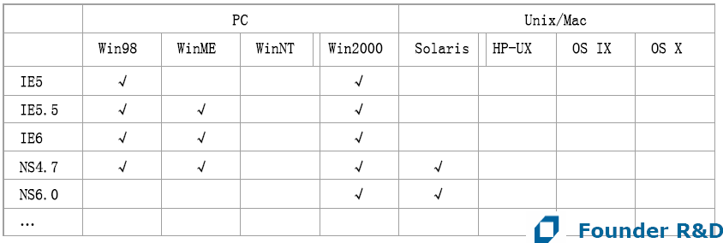
b.2: OATS
OATS (orthogonal matrix testingstrategy)
  Web testing

Slide 11
b.2: New Example
Between Powerpoint 2000/XP and Powerpoint 2003
  A .ppt file is created by Powerpoint 2000/XP, and edited by Powerpoint 2003. Then it cannot be opened by Powerpoint 2003, but can be opened by 2000
    → MS has to release a patch to fix it

Slide 12
c. Standards and Guidelines
1. High-Level Standards and Guidelines
  High-Level standards are the ones that guide your product’s general compliance, it looks and feel, its supported features, and so on
2. Low-Level Standards and Guidelines
  Low-level standards are the nitty-gritty details, such as the file formats and the network communications protocols
  We should treat low-level compatibility standards as an extension of the software’s specification
Notes:
nitty-gritty：事情的本质（the nitty-gritty details本质细节）

Slide 13
d. Data Sharing Compatibility
A well-written program that supports and adheres to published standards and allows users to easily transfer data to and from other software is a great compatible product
  File save and file load
  File export and file import
  Cut, Copy and paste
  DDE (Dynamic Data Exchange), OLE (Object Linking and Embedding)
Application #1
Multiple Data
Formats
System
Clipboard
Single Data
Formats
Application #2
Temporary hold place
Notes:
adhere：遵守
Dynamic Data Exchange：动态数据交换
Object Linking and Embedding：对象链接和嵌入

Slide 14
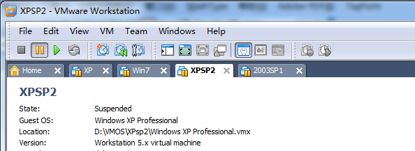
Configuration Testing Environment
Configuration of the testing environment
  Use Removable HDD (Hard Disk Drive) and partition management tools
  Use drive imaging program (ghost) to create an image file for the configuration
  Virtual machine (VMware)
Installation method on the target platform is very important, and should be the same as the end-user

Slide 15
Exercise
Software Testing, Page 151: 3
  If you're assigned to test compatibility of your product's data file formats, how would you approach the task?

